Slide 1
Business Education 4.0: Innovation, Flexibility, and Scalability
Huijue Kelly Duan
Hussein Issa (Presenter)
Miklos Vasarhelyi
Rutgers, The State University of New Jersey

Slide 2
Changing Landscape - Competition

Slide 3
Current Education
Current universities’ curricula has been under scrutiny
Sustainability of higher education institutes
Demand from the business and students
Perceived gap between accounting practice and accounting education
Fast-paced, IT-enabled digital world of education
Association to Advance Collegiate Schools of Business (AACSB)
Encourage the adoption of current and emerging technologies
Review curriculum design and content delivery, innovation, interactive learning environment
CPA Evolution

Slide 4
Emerging Technologies in Business Education
Help higher education institutions face modern challenges
Researchers’ study
Ten emerging technologies to consider (Ahalt and Karamarie, 2017)
Computerized Grading, Electronic Textbooks, Simulation Technology, Gamification, Flipped Classroom, Active Learning Classroom, MOOCs, Collaborative Distance Learning Environments, Active Learning Forum Platform, Learning Management Systems
Learning effectiveness (in-classroom learning, local collaborative telelearning, distant collaborative telelearning) (Alavi, Wheeler, and Valacich, 1995)
Effects of asynchronous learning (Noetel et al., 2021)
Computer-supported learning in improving learning outcomes (Chen et al., 2018)
Mobil-learning (Sung et al., 2017)

Slide 5
Changes in Current Business Education
edX (founded by Harvard and MIT) + 2U Inc
Digital transformation of education
Make higher education available to more students globally
Asynchronous learning, eLearning, distance learning
Adoption of disruptive of technologies
RPA
Blockchain & Smart Contracts
AI-based Predictive Analytics
Prepare student for the future job market
Lower-entry jobs are being eliminated
High-level skilled employees are in demand
Improve professional competence, career adaptability

Slide 6
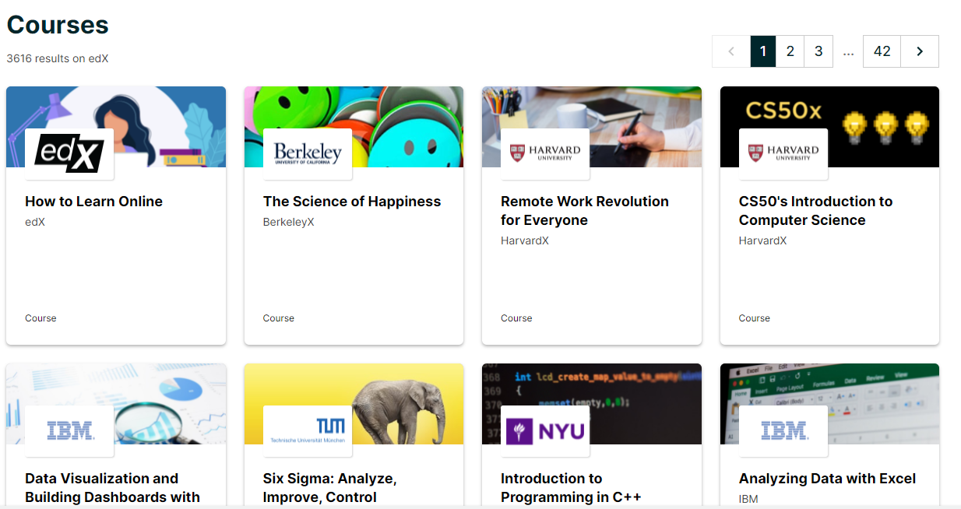
Changing Landscape- Competition
Universities/Colleges
Accounting firms: EY ARC, Deloitte
Publishers: Wiley, McGraw Hill, Pearson
Software Developers: CaseWare, Galavanize, Tableau, Celonis, UiPath
Online education: Coursera, Udemy, Massive Open Online Courses (MOOC)
Specialized entities: AICPA, IMA, IIA
Corporations: Google, J.P. Morgan

Slide 7
What can we do? Fight fire with fire!

Slide 8
SWAM/BYOC Concept

Slide 9
Students’ Needs
Student: So, are you telling me that I can customize my pizza and my subway sandwich, but I cannot tailor my education to my needs and towards achieving my future career goals?
Traditional Universities: Yes, that is correct! We offer a one size fits all education! We have been offering the SAME education for decades and even centuries! Why Change now?
Rutgers University: Wait, that doesn’t sound right! You (student) should be able to tailor the education to best fit your goals and skills. Hence, our Build Your Own Courses (BYOC) education ecosystem!

Slide 10
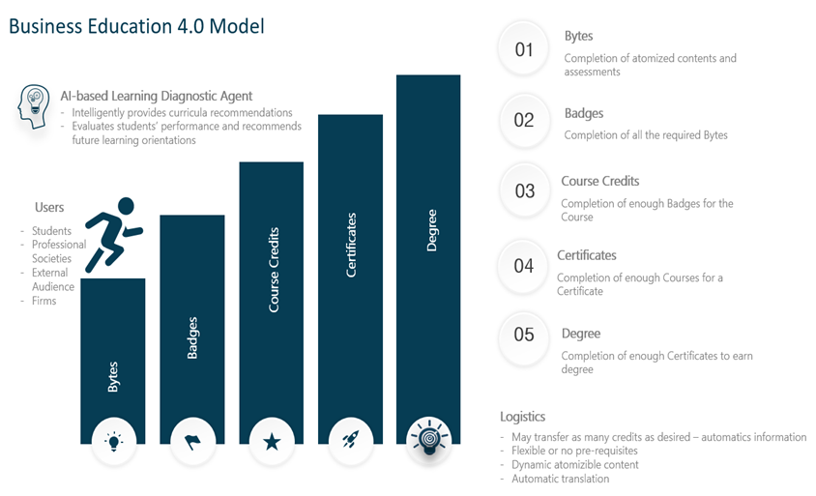
Notes:
Bytes, which consists of various elementary particles of a specific module.
win a Badge once they complete all the required content for a certain module.
Once enough Badges are earned, students can gain Course Credits (in the pilot cases described below, every five modules were equivalent to a 1-credit course), then Certificates, and ultimately a Degree.

Slide 11
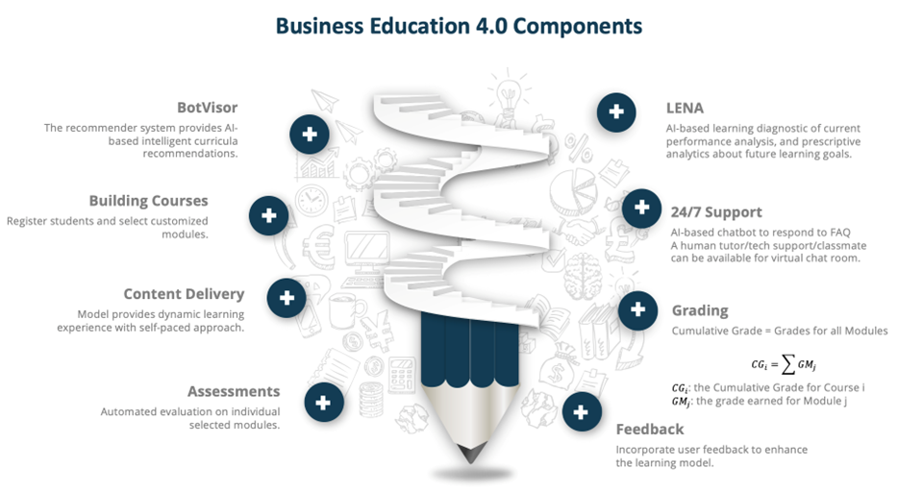
Notes:
BotVisor: This component functions as an AI-based recommender system that takes on the role of a robotic advisor. It intelligently suggests content specialized for each student. BotVisor considers students' background, work experiences, learning preferences, and future career goals to intelligently recommend appropriate learning modules for the students to select from. Additionally, BotVisor also takes into consideration instructor input and adjusts the recommended modules accordingly.
Building the customized courses: Students can register for courses and select modules via their web browser.
Content delivery: The learning platform provides a dynamic learning experience with a self-paced approach. Students can access content using any electronic device, and they can take the course modules whenever and wherever they prefer as long as they have access to the internet.
Assessment: Each module ends with an electronic, automatically graded quiz. Students can see their results immediately and retake the assessment if needed. The instructor can also see the quiz results and monitor students' performance. Upon successful completion of several modules, a student can earn course credit(s), which count towards certificates and formal college degrees.
LENA), evaluates students' performance and conducts prescriptive analytics about future learning orientations. LENA provides students with a personalized learning report to summarize their academic progress and suggest potential areas of improvement.
24/7 Support: An AI-based chatbot is available 24/7 to respond to frequently asked questions.
Grading: For each module, students are graded based on their performance on the associated quiz. The collective modules that would constitute a credit-baring course would be their cumulative grade.
Feedback: User feedback is continuously collected to improve and enhance SWAM. Students provide feedback regarding existing module contents and future interesting topics. Instructor feedback is also used to determine model feature improvement and further development.

Slide 12
Pilot Cases

Slide 13
Meet the Needs from Students and Faculty
Student Needs | Business Education 4.0 Approach
Individual interests | Atomized tailored content
Educational background | Allow unlimited (vetted) credit transfers (cost reduction)
Flexibility with pre-requisites | Progressive learning
Accessibility and Efficient and effective learning | Efficient use of distance learning and other technologies
Up-to-date and relevant content | Teach emerging technologies and tools
Career development | Applications in practice
Faculty Needs | Business Education 4.0 Approach
Increased advising efforts | BotVisor: Initial AI-based advising system, supervised by faculty (material recommender system)
Assessments | Use of AI-based testing (algorithmic tests, automated proctoring) based on atomized topics and modules
Material and content development | Take advantage of existing resources from partner firms, professionals, software development, other faculty
Delivery of content | Efficient use of technologies such as Webex/Zoom (synchronous) and recorded videos and articles (asynchronous)
Grading/Completion | Cumulative Grade based on the atomized assessments: $${CG}_{i}=\sum{{GM}_{j}}$$

Slide 14
Pilot Cases
Audit Analytics - Graduate Level
Students selected 4-5 weeks of learning modules
Data and Descriptive Statistics | Database and SQL
Neural Networks | Business Process Mining
Expert System | Artificial Intelligence and Expert System
Advanced Analytics in Continuous Auditing | Predictive Analytics
Classification | Clustering

Slide 15
Pilot Cases
Build Your Own Courses (BYOC) - Undergraduate Level
Student 1 is interested in Machine Learning & AI
Student 2 is interested in Continuous Auditing
# | Module | Emphasis | Suggested Duration
1 | Basics of Clustering for Audit | Unsupervised Learning in Audit | 5-Week 1-credit hour
2 | Advanced Clustering Methods for Audit
3 | Association Analyses
4 | Anomaly Detection for Audit
5 | Machine Learning Applications
6 | Basics of Classification | Supervised Learning in Audit | 5-Week 1-credit hour
7 | Use of Classifiers in Audit
8 | Advanced Classification Concepts
9 | Basics of Regression Analyses for Audit
10 | Advanced Regression Analyses
11 | Artificial Intelligence in Accounting and Audit (I-V) | Artificial Intelligence and Automation in Audit | 5-Week 1-credit hour
# | Module | Emphasis | Suggested Duration
1 | Basics of Continuous Audit | Continuous Auditing | 5-Week 1-credit hour
2 | Continuous Monitoring
3 | Analyses of Exceptions and Anomalies
4 | System Development and Maintenance for Continuous Audit
5 | Advanced Topics in Continuous Auditing
6 | Basics of Clustering for Audit | Unsupervised Learning in Audit | 5-Week 1-credit hour
7 | Advanced Clustering Methods for Audit
8 | Association Analyses
9 | Anomaly Detection for Audit
10 | Machine Learning Applications

Slide 16
Pilot Cases
Build Your Own Courses (BYOC) - Undergraduate Level
Student 3 is interested in being introduced to different topics
# | Module | Emphasis | Suggested Duration
1 | Basics of Probabilities for Audit | Build Your Own Courses BYOC | 10-Week 2-credit hours
2 | Basics of Statistics for Audit
3 | Intro to Audit Automation
4 | Intro to Process Mining
5 | Introduction into Blockchain: Mining and Hashing
6 | Intro to Crypto Currencies
7 | Basics of Clustering for Audit
8 | Basics of Classification
9 | Basics of Cybersecurity
10 | Intro To Text Analytics

Slide 17
Feedback

Slide 18
Initial Students’ Feedback
Area | Positive Feedbacks | Actions based on students’ feedback
Accessibility | Flexibility in topic/module selection Easy to access all the modules Self-paced learning Instant student progress evaluation | Improve student progress evaluations through LENA
Learning contents | A variety of topics are available Materials are interesting, informative, and influential to accounting and auditing practice in the future Lectures are straightforward explanations of course concepts The quiz is straightforward and highly related to the topic. It is short but comprehensive The quizzes cover all the essential points of the video; it helps the students to reinforce and retain the knowledge | Add additional content Introduce BotVisor LENA to identify areas where students require further help Early warning system using LENA
Recorded content | The majority of the feedback indicated that the length of the video recordings is adequate, and the content fit in students’ learning curve Several students indicated their preference for breaking down specific modules into shorter videos, which makes it easier to digest the information | Break down long videos into shorter submodules.

Slide 19
Survey Participants
Major/Program | # of Students
Undergraduate | 186
Accounting | 27
Business Analytics and IT/Management Information Systems | 12
Finance and Economics | 65
Management and Leadership | 14
Marketing | 14
Supply Chain Management | 28
Other (undecided, mixed majors) | 26
Graduate (MBAs and Specialized Masters) | 34
Total | 220

Slide 20
Findings from the Students Responses
Area | Responses
Drivers (not mutually exclusive) | Interest in the content: 67.3% Needed course credits: 48.2% Flexibility & Accessibility: 40.5% Financial Aid: 4.5%
Content Quality | Score 7, 6: 26.4% Score 5, 4: 56.8% Score 3, 2: 16.3% Terrible (Score 1): 0.5% (1 student)
SWAM Platform | Excellent: 29.6% Good: 44.5% Moderate: 21.8% Poor: 4.1%
Overall Experience | Liked it very much: 79% Somewhat liked it: 19% Did not like it: 2%
Recommend SWAM | Yes: 99.55% No: 0.45% (1 student)

Slide 21
Next Step and Conclusion

Slide 22
Next Step
Expand the literature
Expand the discussion and implications section
Further discussion of the generalizability of the framework
Obtained additional and more detailed feedback from students (surveys)

Slide 23
Conclusion
SWAM
Deliver modularized content
Allows students to customize their learning experience and build their own courses
Provides cutting-edge knowledge
Prepare students for the emerging technological environment
Two pilot cases
Received positive feedback from students
Future development
Implement more features
Explore cross-departmental learning
Collaboration among universities

Slide 25
Benefits
Content: integrating top research
Content: skills of the future auditors
Great supplement to CPA exam requirements
AIS for now, hopefully others will follow
Flexibility
Adaptability to market requirements
Scalable

Slide 26
Challenges
Approvals at school
Student Financial Aid
Lack of LMS
Unfamiliarity
Promoting the concept
Graduate vs. Undergraduate
Integration with existing curricula

